Slide 1
Java application deployment
EPAM DevOps Training
Kurapov Andrii

Slide 2
Agenda
Goals
Tools
Project Structure
Implementation

Slide 3
Goals
Setup cloud infrastructure
Сonfigure Jenkins (Master and Agent)
Configure Docker on Test and Production servers
Automate build and deploy of java app
Imply functionality check for further deployment

Slide 4


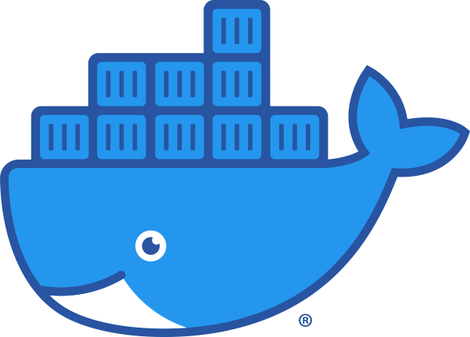

Tools
Git
Jenkins
Docker
AWS

Slide 5



Project Structure
GitHub
Master
Test
Prod
Developer
Review

Slide 6
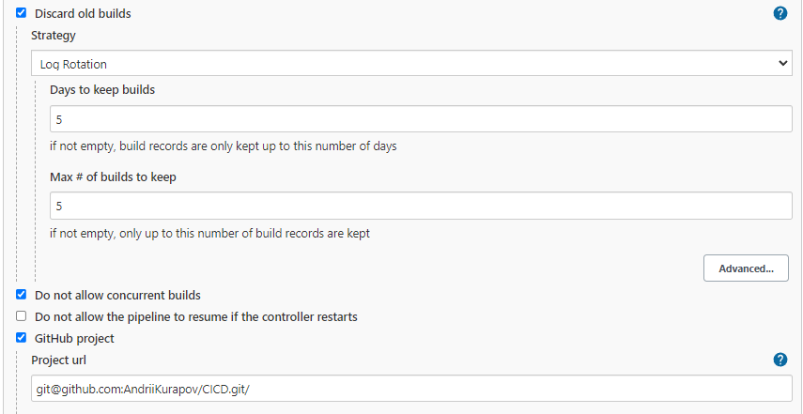
Jenkins general settings

Slide 7
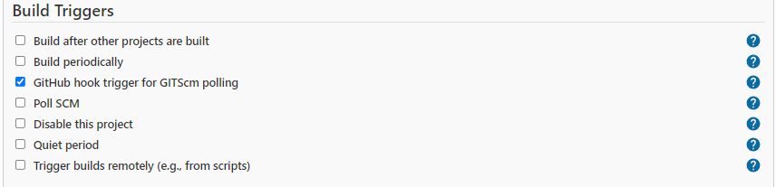
Jenkins build triggers

Slide 8
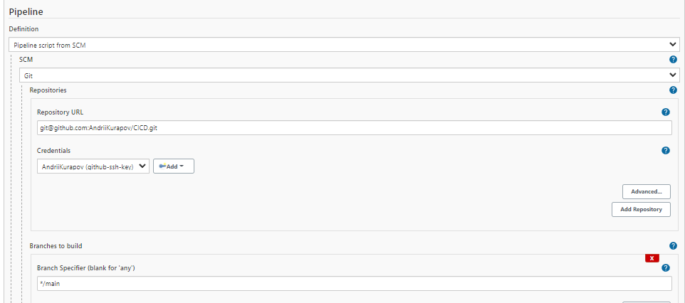
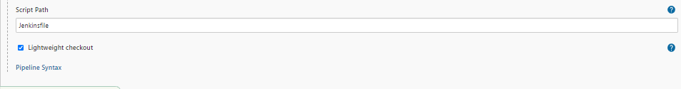
Jenkins pipeline settings

Slide 9
Main job pipeline stages
Build and deploy to test env
Deploy to Prod
Building and deploying code on test environment, sending e-mail notification and waiting for input
Sending necessary files to production server via ssh and deploying code

Slide 10

Docker
Dockerfile configuration

Slide 11
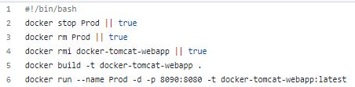
Docker
Bash script

Slide 12
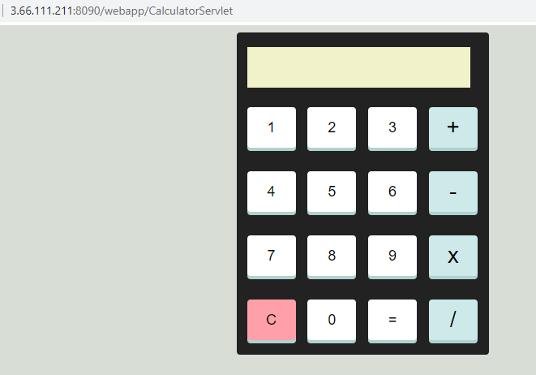
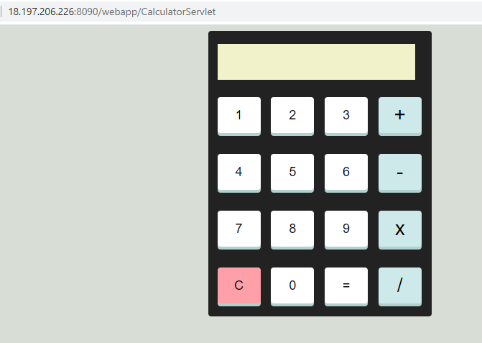
Result
Test Environment
Production Environment

Slide 13
Q & A

